Slide 1

Car management application
Hoàng anh thắng
Văn thành phương đạt

Slide 2
Table of contents
Login Screen
Home Screen
Car Management
Manufacturer Management
Category Management
Invoice Management
Customer Listing Screen

Slide 3
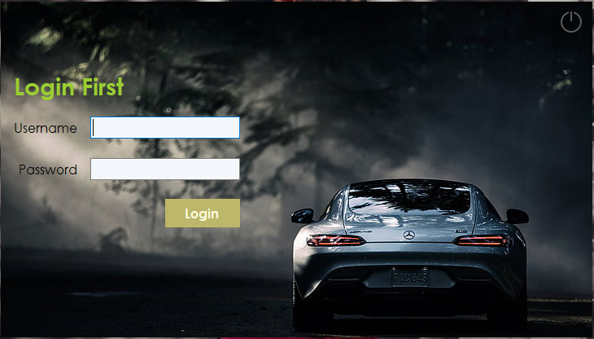
Login screen

Slide 4
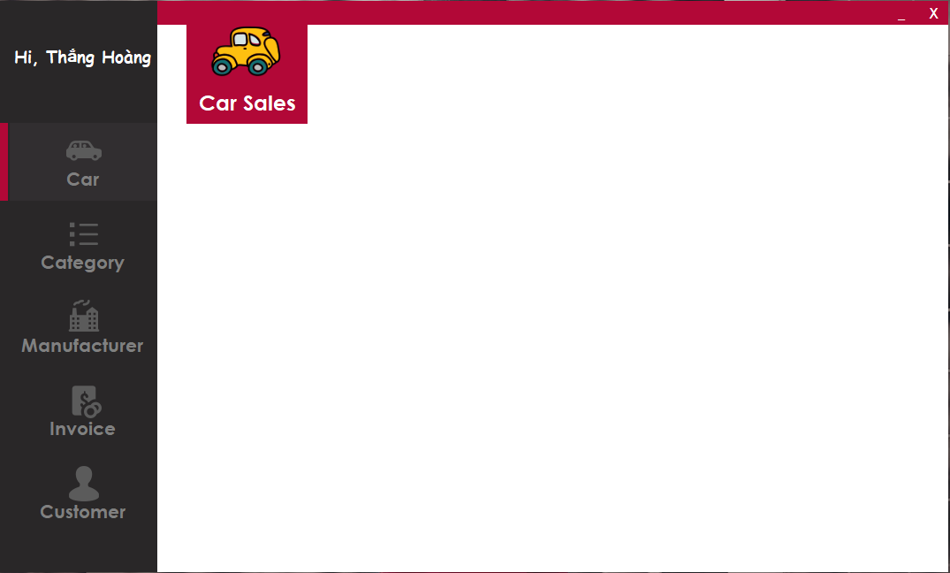
Home screen

Slide 5
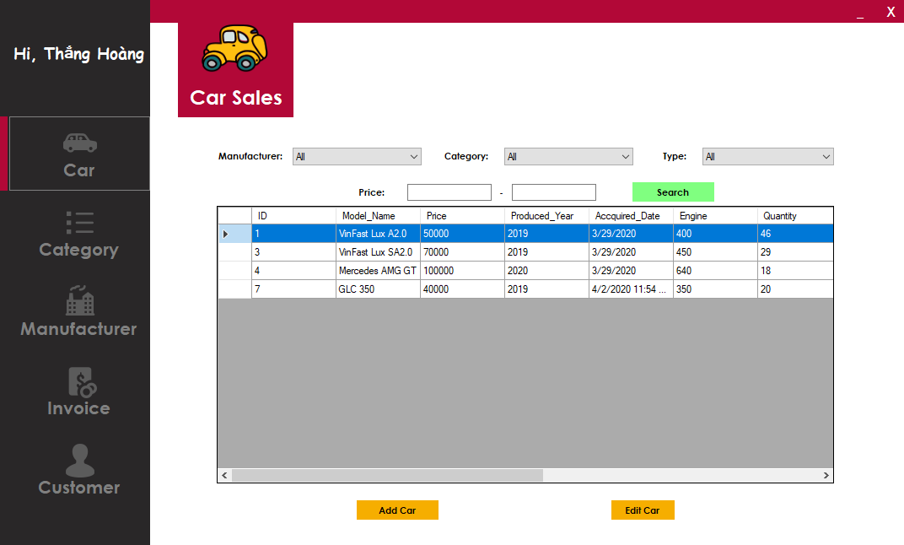
Car listing

Slide 6
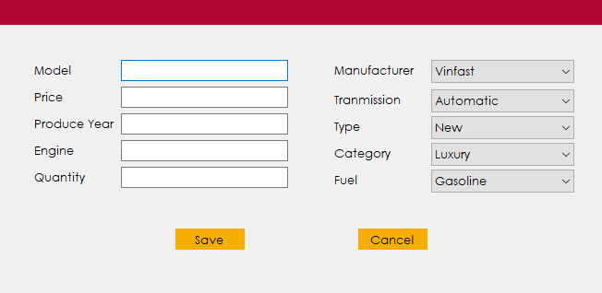
Add new car screen

Slide 7
Car listing

Slide 8
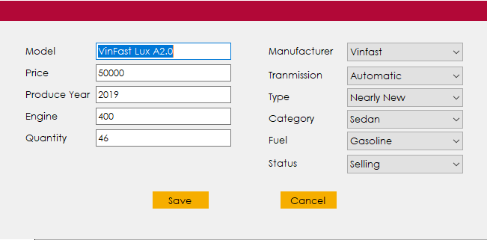
Edit car screen

Slide 9
Home screen

Slide 10
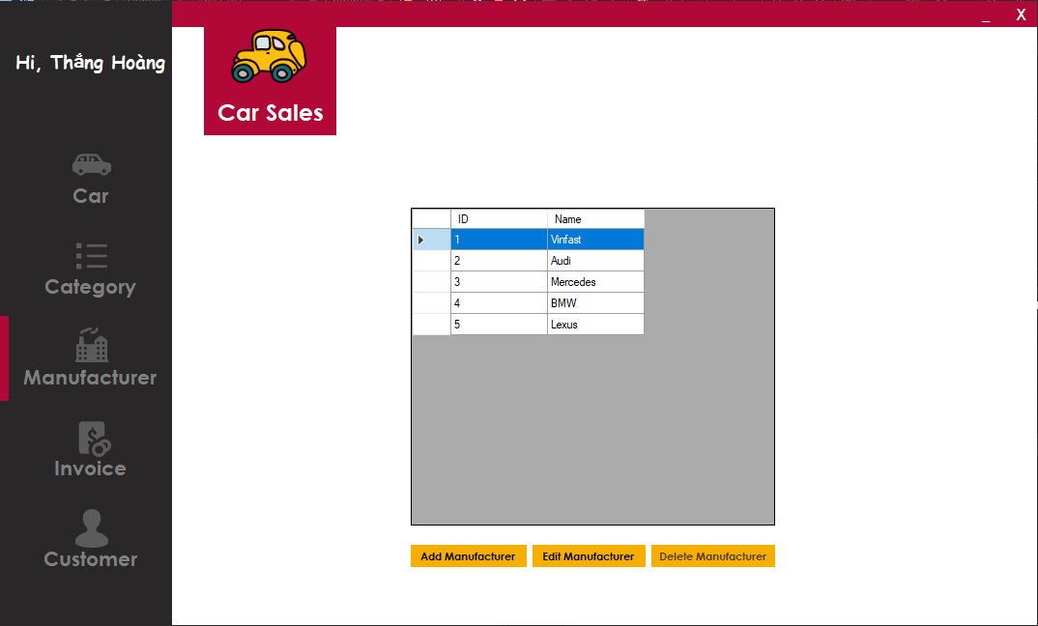
Manufacturer listing

Slide 11
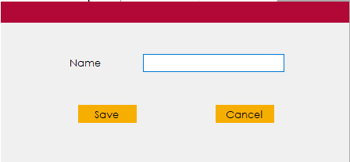
Add new manufacturer screen

Slide 12
Manufacturer listing

Slide 13
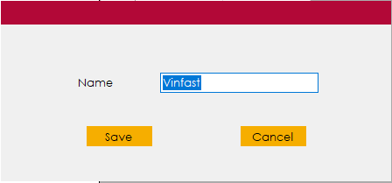
Edit manufacturer screen

Slide 14
Home screen

Slide 15
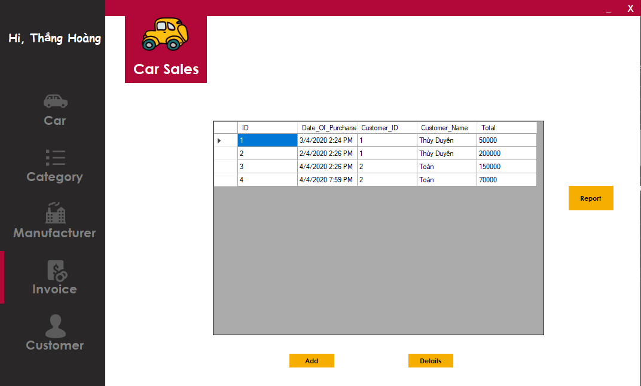
Invoice listing screen

Slide 16
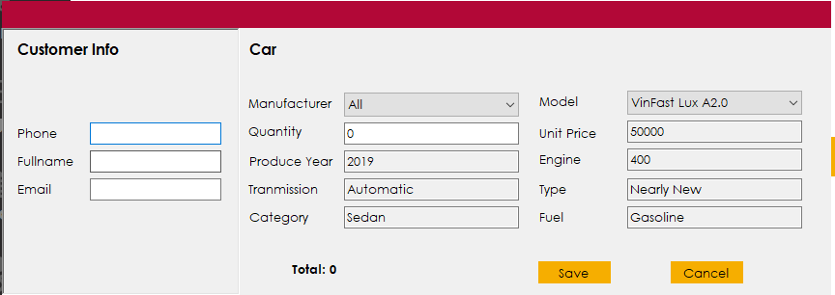
Create invoice screen

Slide 17
Invoice listing screen

Slide 18
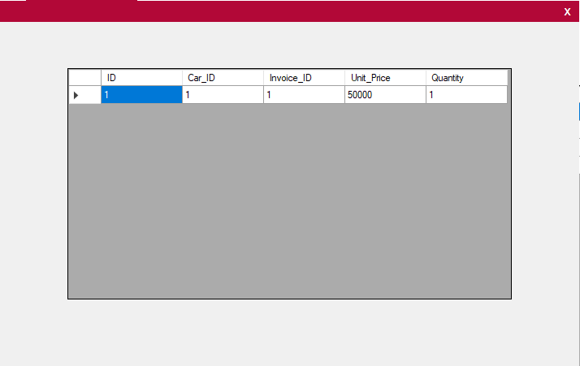
Invoice details screen

Slide 19
Invoice listing screen

Slide 20
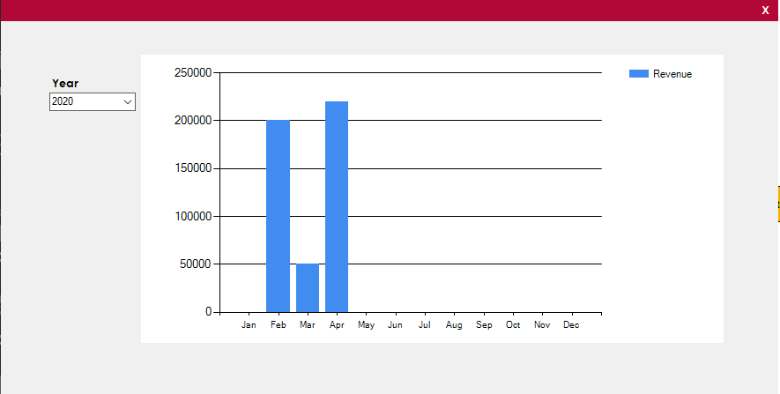
Revenue report screen

Slide 21
Home screen

Slide 22
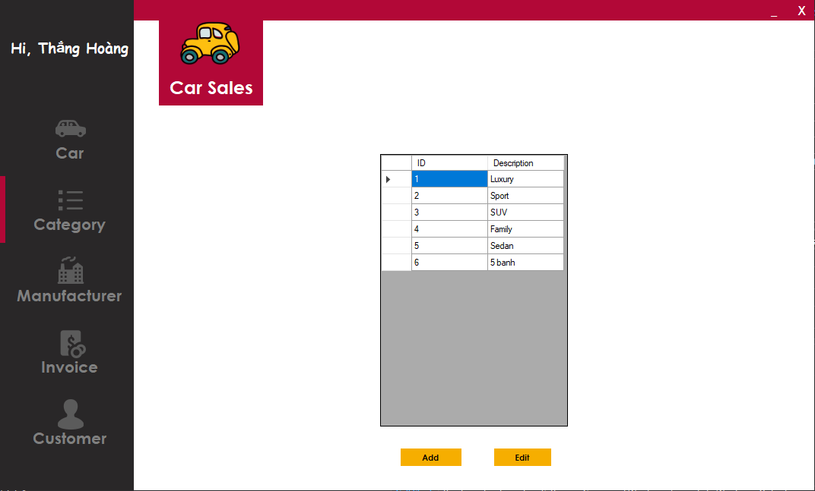
Category listing screen

Slide 23
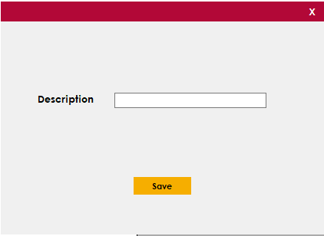
Add new category screen

Slide 24
Category listing screen

Slide 25
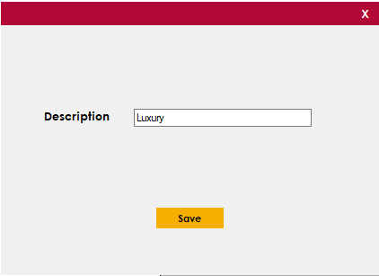
Edit category screen

Slide 26
Home screen

Slide 27
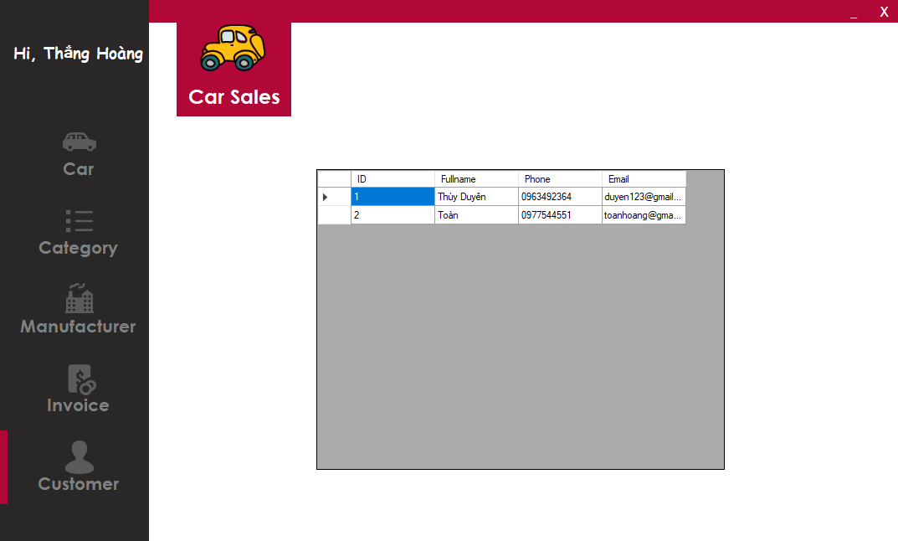
Customer listing screen

Slide 28
THANK YOU FOR YOUR LISTENING! Time for question

